Slide 1


Slide 2
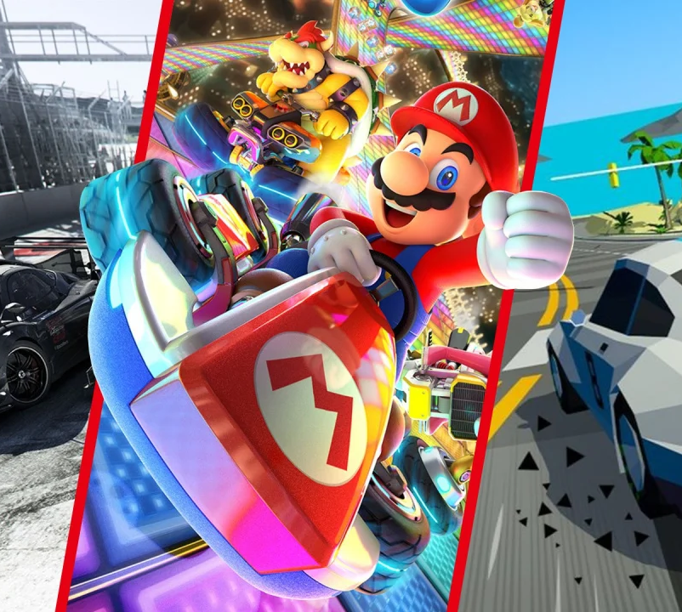
Inhoudsopagave
1. Project description
2. Game design
3. Obstacles
4. The Car
5. The game

Slide 3
1. Project description
Racing game
Fast laps
Realistic visual
Unreal Engine.

Slide 4
2. Game design
Racing game
Semi realistic
Controller

Slide 5
3. Obstacles
Github desktop
Communication error
Unreal engine

Slide 6
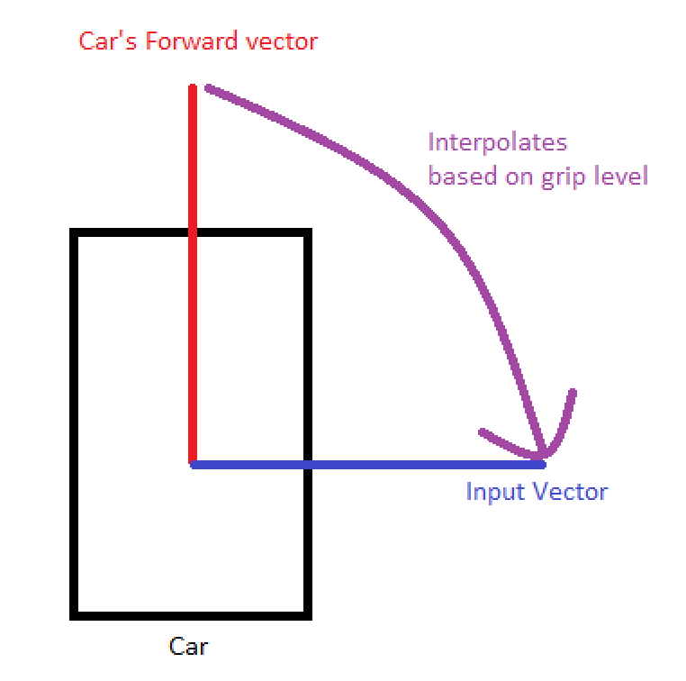
4. The Car
Input
Speed
Steering system
Understeer
Braking
Rumble

Slide 7
5. The game
(Mp4)

